Slide 1
How to use XBee Radios?
A few points of note:
It is notoriously difficult to make them work properly. You can run into any host of issues at any given time. So, it’s important to know ‘what signifies what’.
The device does not matter so much as the antenna and its orientation does.
Debugging an entire circuit which isn’t working properly needs atleast 3 different observational viewpoints. Never operate XBee networks unless the entire team is present.
At any point, 2 laptops with up-to-date XCTU should be present.
Always take into account obstacles between the XBee devices which are actively transmitting.
Debugging should always be done on XCTU and not microprocessors.
XBee radios could be damaged by overvoltage. Preferably do not connect 9V or 5V to the 3.3V input :)
The metal pins underneath are shorted if you place them on a metal surface. To be safe, always operate the modules on newspaper sheets.
Red XBee radio adapter needs microUSB to USB connectors. The arduino connecting adapter is different. Make sure these cables are stored safely or they can be a headache to find.
The network topology (firmware update) of every XBee on a network must be the exact same.
XBee radios can NOT be mounted on breadboards so kindly do not try to forcefully force them in.
Like something else, XBee radios have a certain pull out method to avoid the pins getting bent. Kindly stick to this at all times or else Shubham will get murdered by Daruwala sir.
XCTU Install

Slide 2
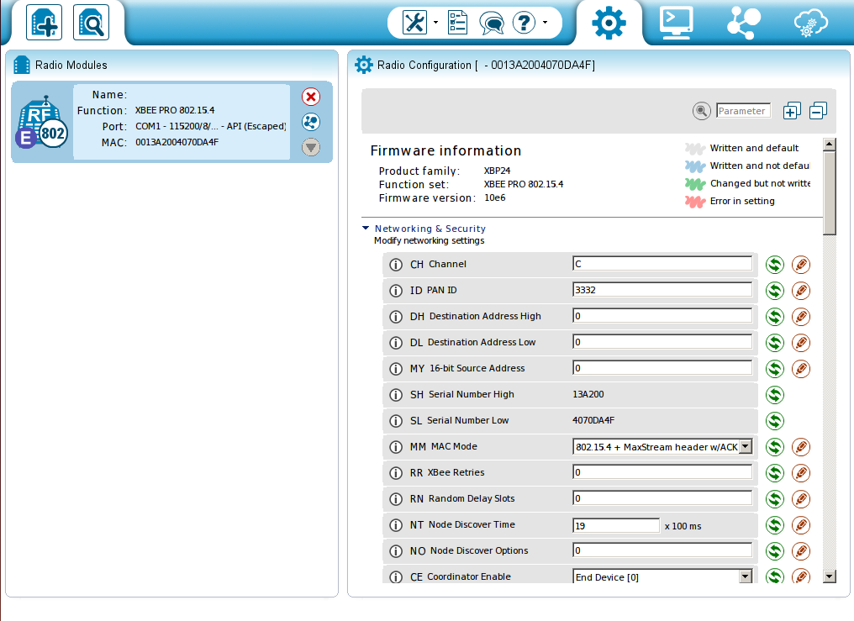
A general checklist to XBee Operation
Mount the XBee radios on the XBee adapter shield. We have two already. One is a red module and the other is a green one. The green one is used for interfacing with the microcontroller.
Ensure the connections are firm.
Connect the red one with microUSB and green one with arduino cable.
Connect both to their respective laptops.
Open XCTU. You will see something like this:
Firstly, click on the second top left icon to scan.
Next, select the appropriate port to which XBee is connected
Then, XCTU will scan for your device. Allow 1min or so
You’ll see a screen similar to the same, here you configure.
Parameters can be changed and updated from here.
XCTU

Slide 3
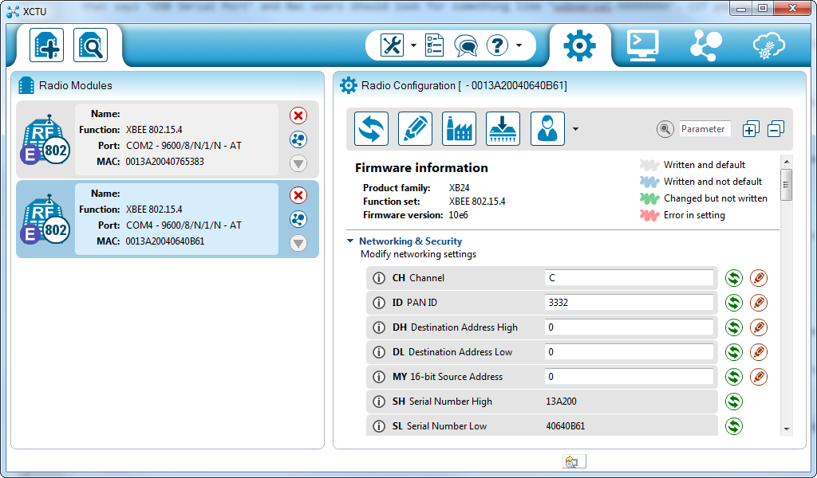
XCTU
XCTU Manual
Here, we configure some important parameters.
PAN ID/NET ID
Channel
Destination MAC HIGH
Destination MAC LOW
(Sometimes) MY 16 bit address
Mode of Operation (API or AT)
Type of Device (Coordinator or End device)
The settings tab is used to set initial fiducials.
Console is used to actually test the connection.
Settings
Console

Slide 4
Console in AT mode
AT (transparent mode) sends out data over RF link, bit-by-bit, without waiting to form a packet structure with defined header and trail bits.
It allows direct data transmission.
We use AT mode for ease of communication and flexibility in packet formations.
In CanSat, the bits are sent so rapidly over the AT link that there is less probability of delay. Also, waiting to form an API frame structure will compromise the integrity of crucial timed procedures.
To test whether our AT link works, firstly both XBee should be set to AT mode.
Next, open the console window and click ‘open’.

Slide 5
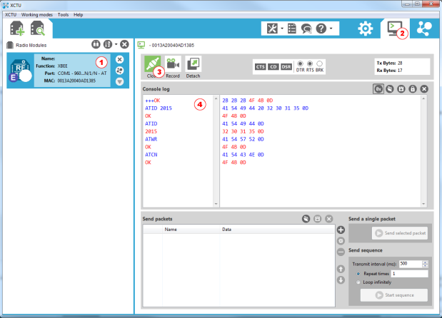
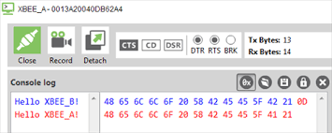
What an XCTU console looks like
This is HEX data!

Slide 6
SOP of design phase
Always ensure connections are proper before plugging into the PC.
Jumper wires and breadboards should not be used unless we are interfacing with microcontrollers.
After ensuring clear LOS, change settings to match whatever you want in the XBee network settings page.
Clear understanding of every parameter and mode is crucial to cracking the problem statement.
You should be able to justify the differences in the different topologies available.
Never disconnect a XBee when it is working.
After settings page is done, always type a few words in console to ensure that link is proper. Sometimes you may think you have set everything correctly, but due to a minor error, everything will fail.
Do not change parameters which you know nothing about. We can’t predict what will happen after they’re changed, adding salt to our wounds.
Always click the write button on the settings page top right to ‘save’ a changed parameter value.

